Slide 1
Fluor ban implementation
Para Nordic Skiing
2024/2025

Slide 2
• FIS confirmed full implementation of the fluor wax ban start to 2023/24 season
• FIS will carry out testing to ensure that skis/boards are fluor-free at top-tier events
  – FIS World Cup
  – FIS World Ski Championships
  - Olympic Games
• Testing at other level events will be carried out on a random basis to ensure those events are also regulated
  – Cooperation with NSAs

Slide 3
FIS has agreed, like the IBU, to ban the use of fluorine waxes, which is mandatory for FIS competitions. Where and how the FIS will control is entirely its decision.
Be sure, that it is in the interest of FIS to make the start of testing as smooth as possible
Please note that FIS will not publish certain information regarding the number of tests and places because some information will stay confidential. ( you will never receive f.e. the detailed list of all doping controls etc.)

Slide 4
Testing Procedure
- FIS Control Team = Equipment Fluor Controller
The control will be carried out randomly at World Cup and WSC competitions.
- The athletes skis can/could be tested before the start and after the finish of the race in the dedicated area as closed as possible to the start

Slide 5
C.C. Testing procedure before the competition
1 pair of ski each athlete
Ski marking: stickers distributed the day before at TCM
-Bib number, number of the pair
Skis delivered to the test area, Zone 1 at latest 45 min before the Race start

Slide 6
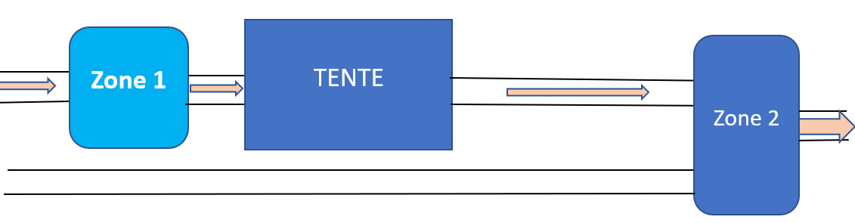
C.C.Testing Procedure – Before Competition
-The technician/athlete put the skis in the designated rack of the Fluor Controller Zone 1.
-No interaction by a steward.
-Skis are tested “tent”.
-All data collected will be register in a data base by FIS.
-After the skis have been delivered in the Zone1, they cannot be touched by anybody, except the fluor testing personnel.
-After being tested, the skis will be delivered in the designated rack Zone 2

Slide 7
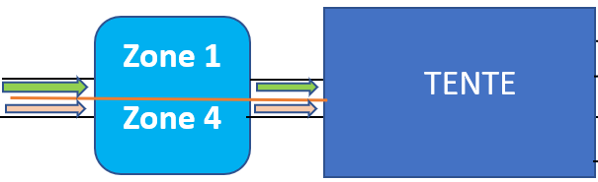

C.C.Testing Procedure – After Competition
-Skis will be delivered to the test area after crossing the finish line, Zone 4
-The athlete put the skis in the designated rack of the Fluor Controller.
-No interaction by a steward or teams.
-Skis are tested (tent).
-All data collected will be register in a data base by FIS.
-After the skis have been tested, they will be placed in the exit Zone 5 in the designated rack and can be collect by athlete or teams.

Slide 8
Red ski
- When an athlete ski is controlled “Red Fluor”, the staff representing the racer will be informed by the Equipment Fluor Controller.
- A maximum amount of two people (athlete include) can come to the tent to collect racing skis.
-If request, the Equipment Fluor Controller, after the end of the race, will show the results that:
will disqualify the athlete after competition (DSQ).
- All data collected will be register in a FIS data base.
- Any remeasurements will not be considered when the “Red Fluor” ski get out of the dedicated Red rack.

Slide 9
ICR
222.8
Use of fluorinated wax or tuning products containing fluorine is prohibited for all
FIS disciplines and levels. Fluorinated wax can be a competitive advantage and its
use in competition will result in disqualification. (see competition rules and
equipment specifications.)

Slide 10
Procedure and summarizing the result
0-1 GREEN, move to next point, up to three points
If >1 RED but remeasure without moving the instrument if <1 GREEN if >1 RED,
Green means green point, Red means red point.
If RED continue to next point
If RED but close to threshold, make a background measurement and remeasure
If RED value is noted move the ski to the side, continue with other skis and then remeasure the previous ski for confirmation

Slide 11


Green/Red Ski
Double check
Double check

Slide 12
Sanctions
Before the start
- 351 Not Permitted to Start, Competitors will not be permitted to start in any FIS international ski competition who:
- 12337.2 violates the FIS rules in regard to equipment (art. 222) and commercial markings (art.207)
- The decision has to be communicated by the Fluor Equipment Controller and is not appealable
- Based on evidence (Testing results)

Slide 13
After the finish
- A positive test will lead to a disqualification (DSQ as per 222.8) of the competitor
- The decision has to be communicated by the Fluor Equipment Controller and is not appealable
- Based on evidence (Testing results)

Slide 14
"In the regulatory sense, fluor controls are considered a material control as defined in ICR rule 222.6. When a ski is indicated red it will be moved to a second instrument and preferably other operator for a second judgement. We do this to minimize any operational influence on the result i.e. we want to be able to reproduce the result. Both in terms of hardware and human error. In the cases where this is not possible no extra instrument or personnel. The extra measurement will be conducted on the same instrument and same person but with a delay were other skis have been measured in between.
Decisions after the testing procedure described above cannot be appealed against, as set out in ICR rule 222.6.1 ("At all FIS events where official FIS measurement experts using the official FIS measurement tools are appointed, the result of measurements carried out at the time are valid and final, irrespective of previous measurements")."

Slide 15
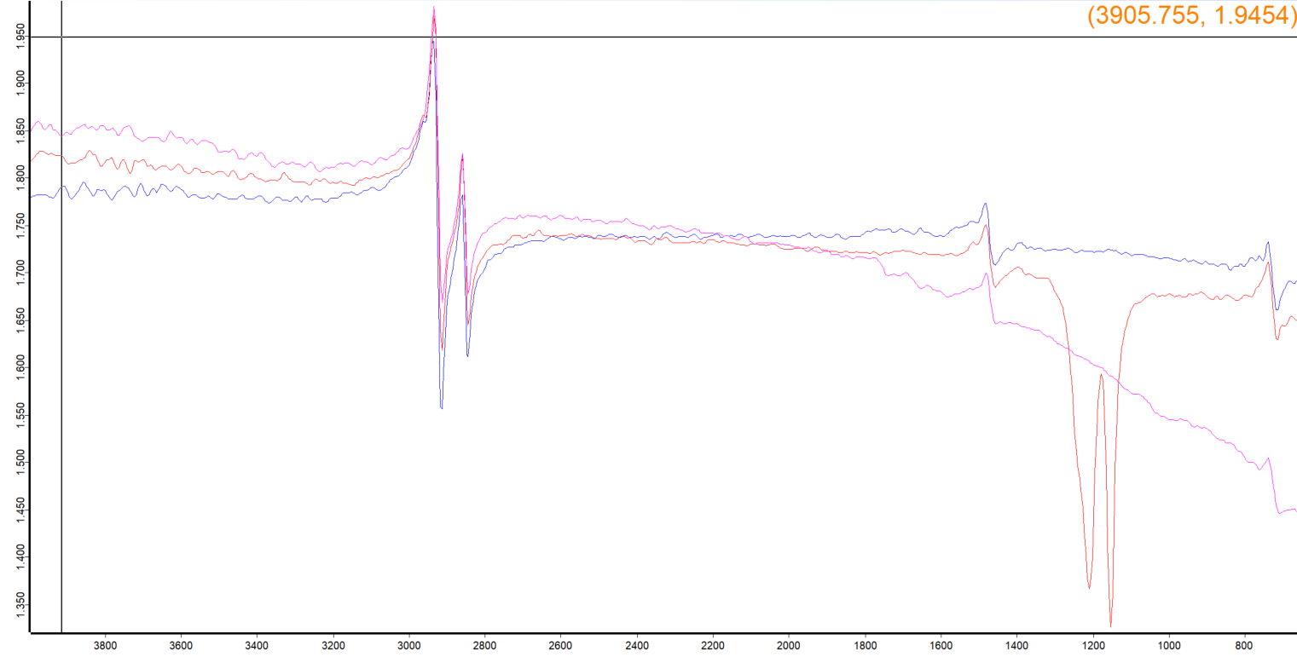
C-H stretch
C-H bending
„Fingerprint region“

Slide 16
Material provided by Fluor Equipment Controller:
-Device, PC and all necessary hardware to do measurements

Slide 17
Material/Manpower needed from OCs:
-Slide 6 shows the setup of the testing area for Fluor. LOC in coorperation with EQC´s to find the best setup possible to ensure smooth and effective testing procedure before and after the race.
-Fenced zone to mount the tent, as flat as possible, next to the start
-Tent, size 3mX6m with sidewalls/container
-Floor, any not slippery material, size 3mX6m
-Heating (not a blower)
-Reliable electric power source (110/220 Volts)

Slide 18
- 1or 2 table size(2mX0,75m) depending on the number of devices
- 1or 2 chairs
- 4X skis racks
- 2 or more assistant from 1hour before the start until the end of the race
-Transport of the Fluor Equipment Controller material if his car couldn’t reach the finish area

Slide 19
Personnel and responsibilities
1 Fluor Equipment Controller:
Directly involved and responsible for the organisation of fluor testing before and during the event
        Responsible for smooth flow of the fluor testing on site
        The only person to communicate with the Jury and RDs
        Collects information from teams and SRS about development in ski waxing to improve the testing “models”
        Accommodation and travel costs covered by FIS
        The Fluor Equipment Controller is on FIS payroll

Slide 20
2-4 LOC assistant: depending on the number of the devices
Jury: Receives information from the Fluor Equipment Controller
        Makes decision about DSQ and potential sanctions

