Slide 1
Fluor ban implementation
Para Snow Sports
2024/2025

Slide 2
• FIS confirmed full implementation of the fluor wax ban start to 2023/24 season
• FIS will carry out testing to ensure that skis/boards are fluor-free at top-tier events
– FIS World Cup
– FIS World Ski Championships
-Olympic Games
• Testing at other level events will be carried out on a random basis to ensure those events are also regulated
– Cooperation with NSAs

Slide 3
FIS has agreed, like the IBU, to ban the use of fluorine waxes, which is mandatory for FIS competitions. Where and how the FIS will control is entirely its decision.
Be sure, that it is in the interest of FIS to make the start of testing as smooth as possible
Please note that FIS will not publish certain information regarding the number of tests and places because some information will stay confidential. ( you will never receive f.e. the detailed list of all doping controls etc.)

Slide 4
Testing Procedure
FIS Control Team = Equipment Fluor Controller
The control will be carried out randomly at World Cup and WSC competitions.
- The testing will be performed at the finish area in a dedicated tent /for SX-SBX-SB, finish area next to the exit gate

Slide 5
Testing Procedure After Competition
ALPINE
-The athletes’ skis/boards can/could be tested after finishing the race (speed events)
-On the tech events, random checks can/could be conducted during the first and second run, during the first run we try to minimize the time that we keep the skis/boards for control
SX-SBX-SB Alpine
-1 or 2 athletes can/could be randomly tested from the first heat until the final
-Top 4 athletes mandatory tested after the final

Slide 6
Testing Procedure After Competition
Skis/boards delivered to the Fluor Test Area
2. The athlete personally put the skis/boards in the designated rack of the Fluor Equipment Controller.
3. Skis/boards are tested (tent).
4. All data collected will be register in a data base by FIS.
5. After the skis/boards have been tested, they will be placed in the designated rack and can be collect by athletes or teams.

Slide 7
Red ski/board
- When an athlete ski/board is controlled “Red Fluor”, the staff representing the racer will be informed by the Equipment Fluor Controller.
- A maximum amount of two people (athlete include) can come to the tent to collect racing skis/boards.
-If request, the Equipment Fluor Controller, after the end of the race, will show the results that:
will disqualify the athlete after competition (DSQ).
- All data collected will be register in a FIS data base.
- Any remeasurements will not be considered when the “Red Fluor” ski/board get out of the dedicated Red rack.

Slide 8
ICR
222.8
Use of fluorinated wax or tuning products containing fluorine is prohibited for all
FIS disciplines and levels. Fluorinated wax can be a competitive advantage and its
use in competition will result in disqualification. (see competition rules and
equipment specifications.)

Slide 9
Procedure and summarizing the result
0-1 GREEN, move to next point, up to three points
If >1 RED but remeasure without moving the instrument if <1 GREEN if >1 RED,
Green means green point, Red means red point.
If RED continue to next point
If RED but close to threshold, make a background measurement and remeasure
If RED value is noted move the ski to the side, continue with other skis and then remeasure the previous ski for confirmation

Slide 10
Green/Red Ski
Double check
Double check

Slide 11
Sanctions
After the finish
- A positive test will lead to a disqualification (DSQ as per 222.8) of the competitor
- The decision has to be communicated by the Fluor Equipment Controller and is not appealable
Based on evidence (Testing results)

Slide 12
"In the regulatory sense, fluor controls are considered a material control as defined in ICR rule 222.6. When a ski is indicated red it will be moved to a second instrument and preferably other operator for a second judgement. We do this to minimize any operational influence on the result i.e. we want to be able to reproduce the result. Both in terms of hardware and human error. In the cases where this is not possible no extra instrument or personnel. The extra measurement will be conducted on the same instrument and same person but with a delay were other skis have been measured in between.
Decisions after the testing procedure described above cannot be appealed against, as set out in ICR rule 222.6.1 ("At all FIS events where official FIS measurement experts using the official FIS measurement tools are appointed, the result of measurements carried out at the time are valid and final, irrespective of previous measurements")."

Slide 13
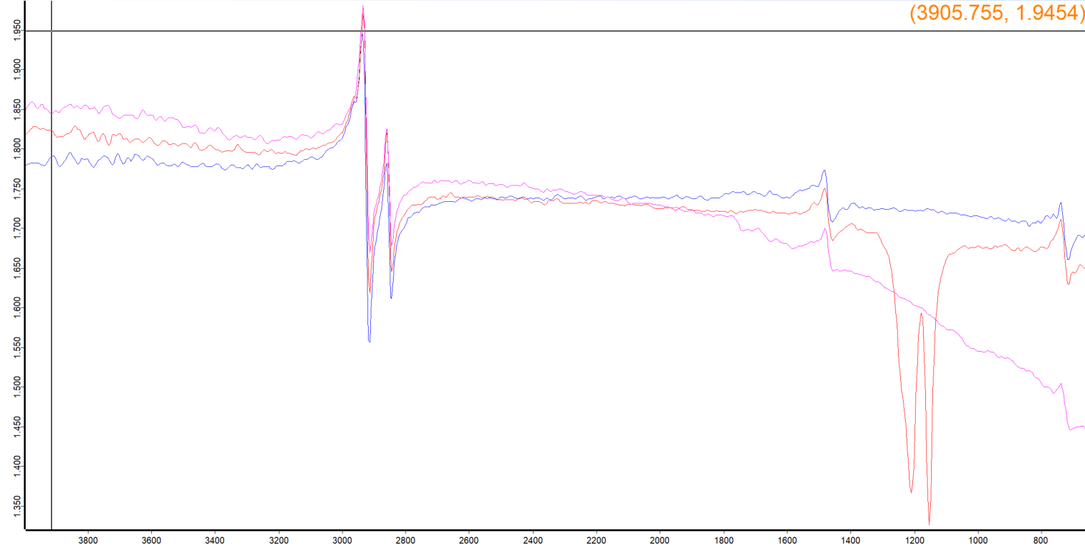
C-H stretch
C-H bending
„Fingerprint region“

Slide 14
Material provided by Fluor Equipment Controller:
-Device, PC and all necessary hardware to do measurements

Slide 15
Material/Manpower needed from OCs:
-Fenced zone to mount the tent, as flat as possible, next to the start
-Tent, size 3mX6m with sidewalls/container
-Floor, any not slippery material, size 3mX6m
-Heating (not a blower)
-Reliable electric power source (110/220 Volts)

Slide 16
- 1 table size approx.(2mX0,75m)
- 1or 2 chairs
- 2X skis racks
- 2 or more assistant from 1hour before the start until the end of the race
-Transport of the Fluor Equipment Controller material if his car couldn’t reach the finish area

Slide 17
Personnel and responsibilities
1 Fluor Equipment Controller:
Directly involved and responsible for the organisation of fluor testing before and during the event
Responsible for smooth flow of the fluor testing on site
The only person to communicate with the Jury and RDs
Collects information from teams and SRS about development in ski waxing to improve the testing “models”
Accommodation and travel costs covered by FIS
The Fluor Equipment Controller is on FIS payroll

Slide 18
1-2 LOC assistant: depending on the number of the devices
Jury: Receives information from the Fluor Equipment Controller
Makes decision about DSQ and potential sanctions

