Slide 1
EVENT NAME 00/00 DECEMBER 2020
TEAM CAPTAINS‘ MEETING

Slide 2
AGENDA
Roll Call
Introduction of the OC and the Jury
Event Program
Venue Overview
Timetable
Weather Forecast
Entries and draw
Stadium
Courses
Ski testing and warming up
Course Preparation and Grooming
Information from the TD
Information from FIS
Information from the OC

Slide 3
ROLL CALL
AND
AUS
AUT
BLR
CAN
CZE
EST
FIN
FRA
GER
GRE
ITA
JPN
KAZ
NOR
POL
RSA
RUS
RUS
SLO
SUI
SVK
SWE
UKR
USA

Slide 4
INTRODUCTION OF THE LOC AND JURY
LOC
Chair:
Chief of competition:
Accommodation:
Transportation:
Payment:
Race Secretary:
Jury
TD:
TD Assistant:
National TD:
Chief of Competition:
RD:

Slide 5
EVENT PROGRAMME
Most important dates and times
Competitions (including other disciplines)
Opening Ceremony (or other like bib ceremony)
TCMs
Official Prize Giving Ceremony
Other events

Slide 6
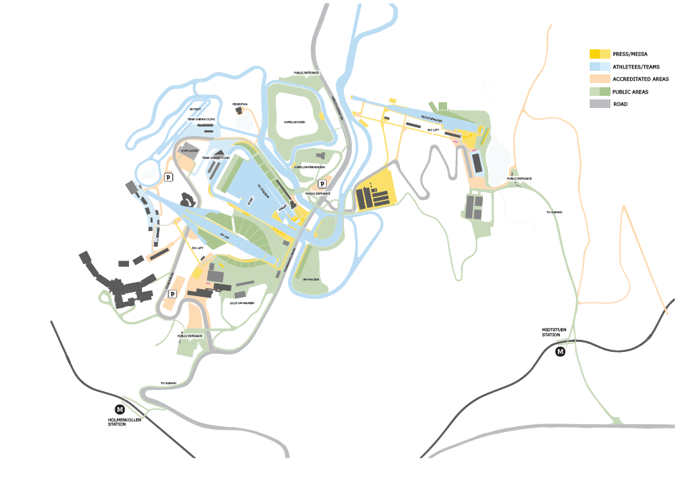
VENUE OVERVIEW
EXAMPLE

Slide 7
TIMETABLE
Add timetable with:
Course opening times (ski testing and warming up)
Competition times
For sprint competitions: TCM 2, semi finals and finals times
Winner ceremonies times (Top 3)
Prize Giving Ceremonies times and location (Top X?)
Print this page

Slide 8
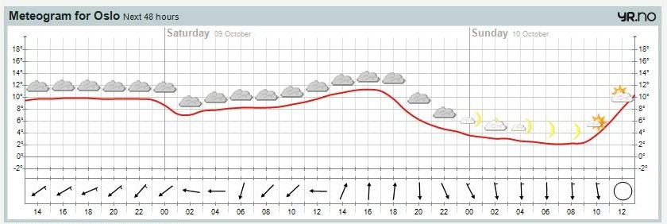
WEATHER FORECAST
EXAMPLE
Print in A4 format

Slide 9
ENTRIE & START LIST
Add if necessary information concerning:
Bibs sponsor for women and men
Leg bibs position

Slide 10
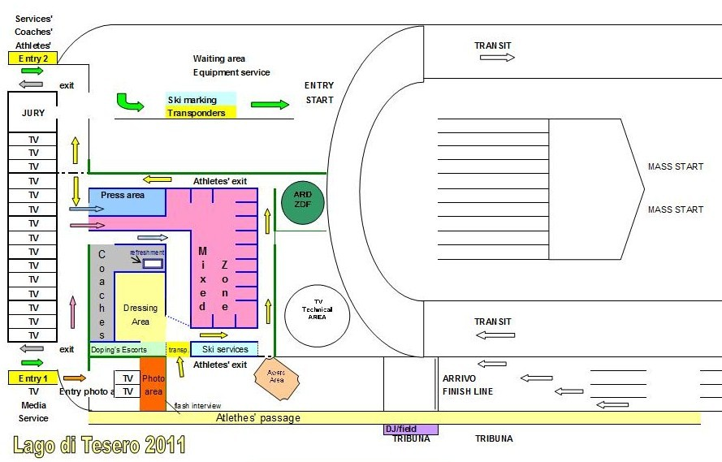
STADIUM
Venue overview
EXAMPLE

Slide 11
COURSE PREPARATION & GROOMING
Schedule for Grooming
Salting?
Re grooming plans in case of difficult weather conditions
Individual Starts, Sprints, Pursuit Starts: track setting and start positions
Classical technique competitions: Track setting
Don’t forget to ask to the Team Captains if they have any comments concerning the course, track setting, course preparation…
Print this page

Slide 12
GENERAL INFORMATION FROM THE LOC
Copytext dark blue … rem volupta volorestotat a vero estibus sinciis dolestibus, sunde dere nos aperibe rsperum evendus am fugiam, volorep uditia volupta quam in pra consenisque volorum cuptas dem laut arunt alit, exerore stiae. Raerovit rem sinciis sequamet latem quibus ius.
Copytext grey … nam iliquate nimuscipsam que conecae. Et a nimagnaturit aut fugiatiorem con nonsectaque nos dicil in eturiorerum que etusand aepelig nimaio eos quam assitat ibuscim quostor sim quid ma doluptur ad ut doluptis explitio et quam sitibusam quis rerumqui oditios alit, nempersperum eatemporion providu cientem que volutas perepra tiostem re perro moluptur, volorro ommolup tatur?
Leniene essimagnia sam, net, que cor simodi aciis qui doluptatemo blam, essi blab inci dolenimus simint.
Rumquibus. Natiatiur, iure delenimetur sequid esto omnis ad millande landelit pa sum eos eos provides molupiet aceperi onestius poribust, ommodi ulpa sequistrum alibust acepell endions equiasp erepudaecum velit pa vel imperit etusda apis conet harum vene nobis ipsaectius qui omnianditis magnis quatis quist voluptas cupicia solut volores modit optae si unt modipiet lacero et doluptatur as inum ipicab is ab incium, quat fugite cor alit laut quia veria asperemo eatus evenimi nisciam experep editatem fugianimusam rectiasitium volore vent eostintibusa voluptatem.

Slide 13
GENERAL INFORMATION FROM TD
Copytext dark blue … rem volupta volorestotat a vero estibus sinciis dolestibus, sunde dere nos aperibe rsperum evendus am fugiam, volorep uditia volupta quam in pra consenisque volorum cuptas dem laut arunt alit, exerore stiae. Raerovit rem sinciis sequamet latem quibus ius.
Copytext grey … nam iliquate nimuscipsam que conecae. Et a nimagnaturit aut fugiatiorem con nonsectaque nos dicil in eturiorerum que etusand aepelig nimaio eos quam assitat ibuscim quostor sim quid ma doluptur ad ut doluptis explitio et quam sitibusam quis rerumqui oditios alit, nempersperum eatemporion providu cientem que volutas perepra tiostem re perro moluptur, volorro ommolup tatur?
Leniene essimagnia sam, net, que cor simodi aciis qui doluptatemo blam, essi blab inci dolenimus simint.
Rumquibus. Natiatiur, iure delenimetur sequid esto omnis ad millande landelit pa sum eos eos provides molupiet aceperi onestius poribust, ommodi ulpa sequistrum alibust acepell endions equiasp erepudaecum velit pa vel imperit etusda apis conet harum vene nobis ipsaectius qui omnianditis magnis quatis quist voluptas cupicia solut volores modit optae si unt modipiet lacero et doluptatur as inum ipicab is ab incium, quat fugite cor alit laut quia veria asperemo eatus evenimi nisciam experep editatem fugianimusam rectiasitium volore vent eostintibusa voluptatem.

Slide 14
GENERAL INFORMATION FROM FIS
Copytext dark blue … rem volupta volorestotat a vero estibus sinciis dolestibus, sunde dere nos aperibe rsperum evendus am fugiam, volorep uditia volupta quam in pra consenisque volorum cuptas dem laut arunt alit, exerore stiae. Raerovit rem sinciis sequamet latem quibus ius.
Copytext grey … nam iliquate nimuscipsam que conecae. Et a nimagnaturit aut fugiatiorem con nonsectaque nos dicil in eturiorerum que etusand aepelig nimaio eos quam assitat ibuscim quostor sim quid ma doluptur ad ut doluptis explitio et quam sitibusam quis rerumqui oditios alit, nempersperum eatemporion providu cientem que volutas perepra tiostem re perro moluptur, volorro ommolup tatur?
Leniene essimagnia sam, net, que cor simodi aciis qui doluptatemo blam, essi blab inci dolenimus simint.
Rumquibus. Natiatiur, iure delenimetur sequid esto omnis ad millande landelit pa sum eos eos provides molupiet aceperi onestius poribust, ommodi ulpa sequistrum alibust acepell endions equiasp erepudaecum velit pa vel imperit etusda apis conet harum vene nobis ipsaectius qui omnianditis magnis quatis quist voluptas cupicia solut volores modit optae si unt modipiet lacero et doluptatur as inum ipicab is ab incium, quat fugite cor alit laut quia veria asperemo eatus evenimi nisciam experep editatem fugianimusam rectiasitium volore vent eostintibusa voluptatem.

Slide 15
THANK YOU FOR YOUR ATTENTION!

